Slide 1
GameStop & r/wallstreetbets Analysis
-author-
Amber Paige Webber

Slide 2
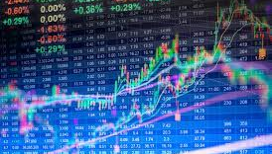

The data used in this report was collected through various sites like, “Kraggle” and “Bloomsberg”. The data was joined with intentions to compare events that occurred during certain time periods. After the conclusion section, you will find a list of sources that were used in the construction of this report. I did not modify the sources that were used in this report.

Slide 3

When the subreddit r/wallstreetbets members started discussing investing in the GameStop stock, GME, in mid-2019, they didn’t quite have an idea of just where that was going to lead them to. A build up of the stock being mentioned and the talk about taking down hedge fund managers in this subreddit led to more and more amateur investors, investing their money into GameStop and soon saw that they were increasing their share closing prices. It exploded from there, where at once a share of GME was merely $14, it rose as high as $347.51.
$14 $347.51
If it were not for the constant chatter about the GameStop stock, GME, the price would have never rose as high as it did.

Slide 4
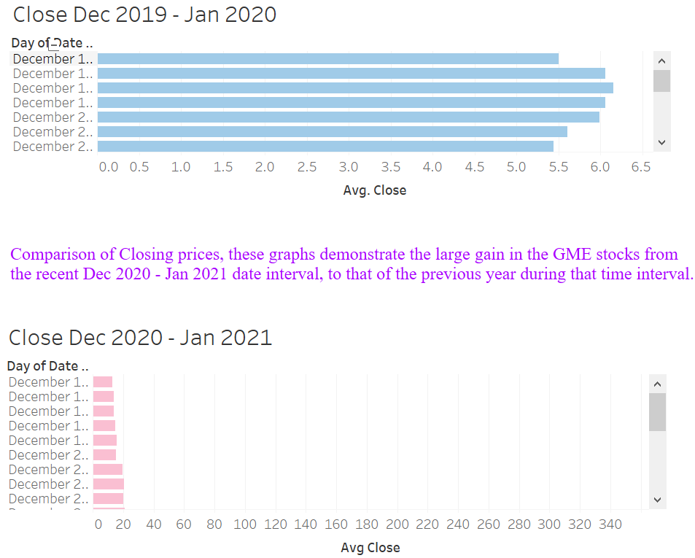

Note 1: These dates are showing from Dec 1, 2019 – Dec 2, 2020
Note 2: Notice the interval for Average closing price is between $0.0 – $6.5.
Note 2: These dates are showing from Dec 1, 2020 – Dec 2, 2020
Note 2: Notice the interval for Average closing price is between $0 – $360.

Slide 5
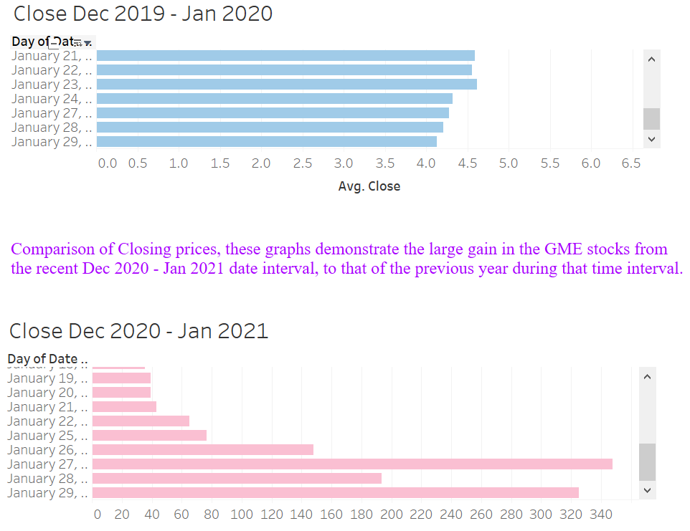
Note 1: These dates are showing from Jan 21, 2020 – Jan 29, 2020
Note 2: Notice the interval for Average closing price is between $0.0 – $6.5.
Note 3: These dates are showing from Jan 19, 2021– Jan 29, 2021
Note 4: Notice the interval for Average closing price is between $0 – $360.

Slide 6
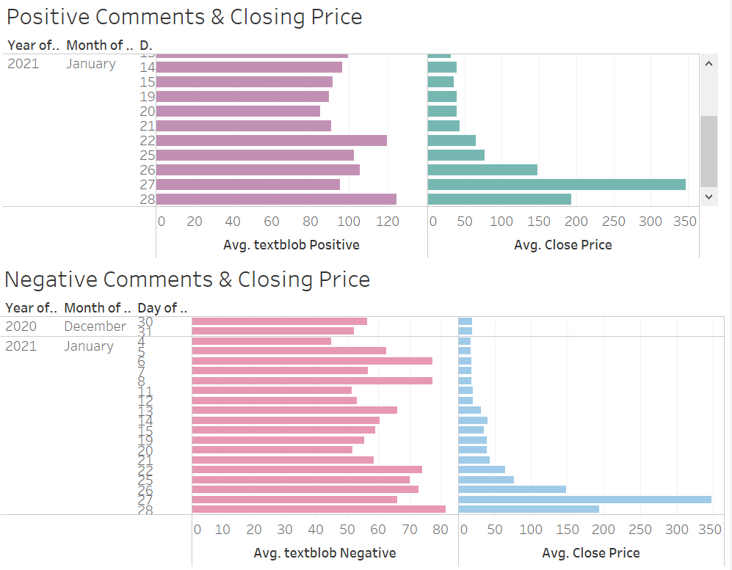
Most of the comments mentioned about the GME stock, in the subreddit r/wallstreetbets, were mentioned in more of a positive light when comparing days. Which would then lead me to believe that because buying into the GME stock was increasing the positive attitude as the share prices increased, it then led to the increase of positive comments in regard to buying GME shares and kept the cycle going in which more and more people bought GME shares.

Slide 7
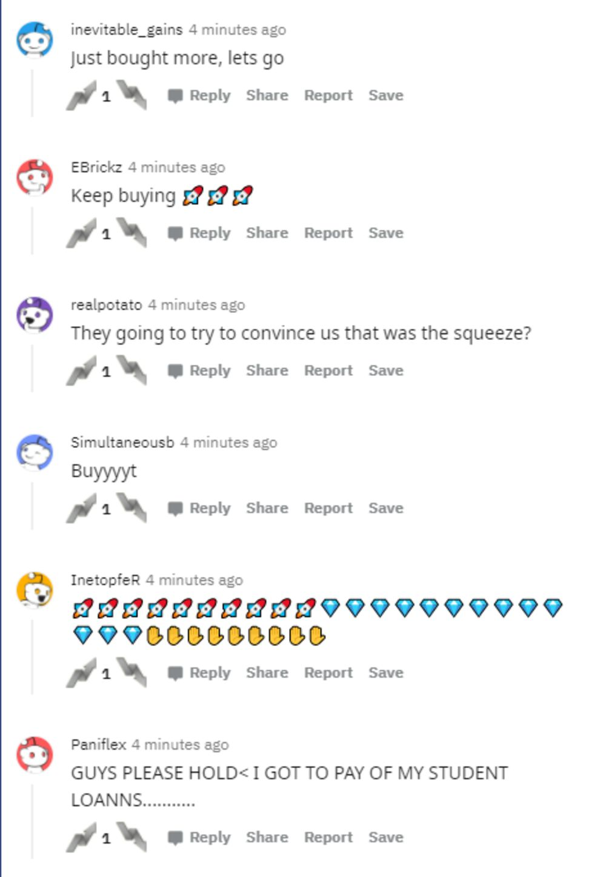
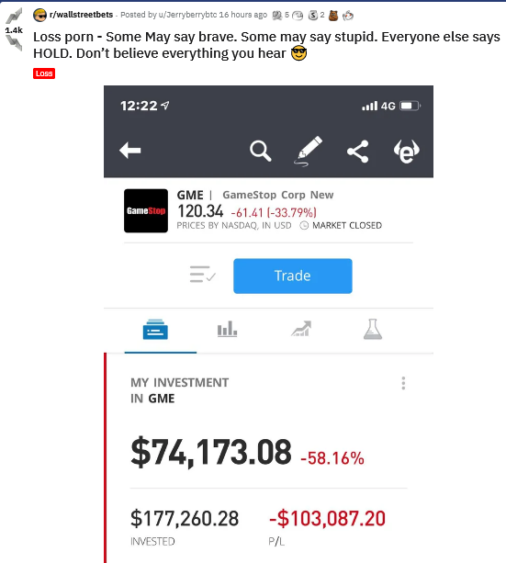
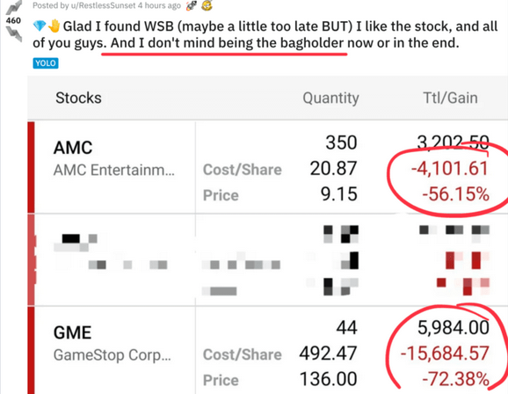
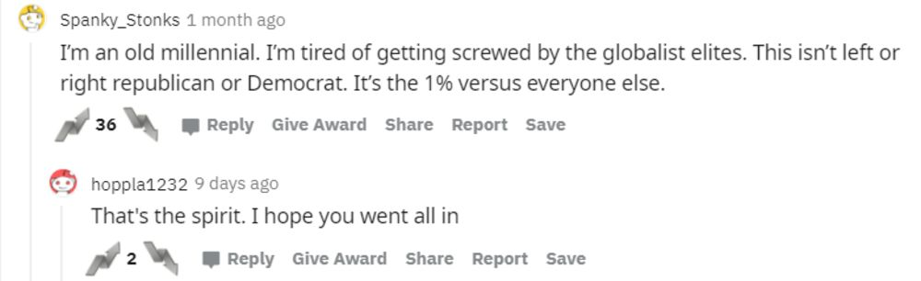
Some of the positive & negative comments
Figure A
Figure D
Figure C
Figure B

Slide 8
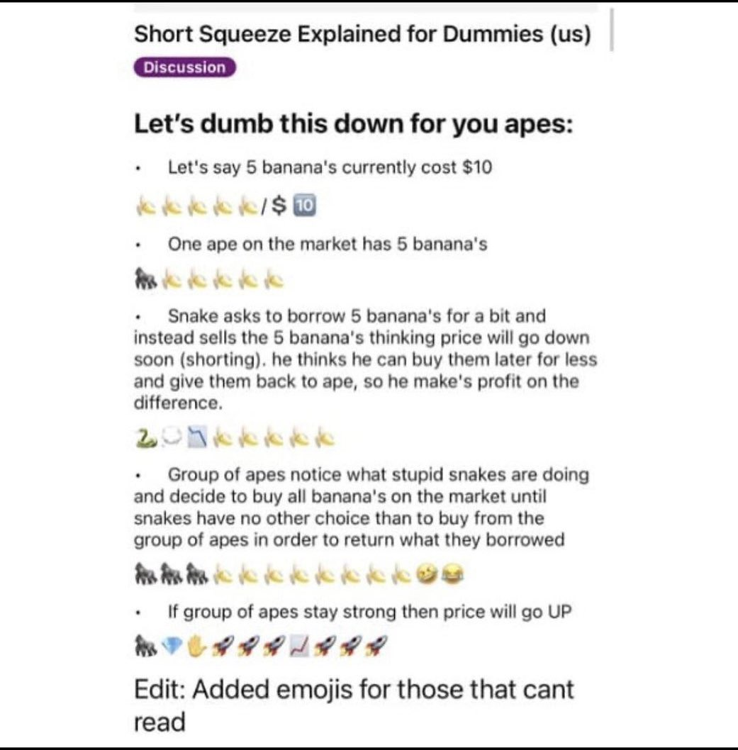
A breakdown of the process that took place, explained by a reddit user. Posts like these that inform the amateur investor and encourages the investors to keep holding and buying is why the GME stock took off as quickly as it did after gaining steam.

Slide 9

Data Issues
1. Finding data sources that had similar date formats was a bit of a process. I would find great sources only to discover as I joined them that their dates varied and couldn’t be used as a comparison. For instance, one dataset would have the “Date” category as: 2021/12/05 12:00, while another was in the format: 05/12/2021, and would not have a time listed. I did like that the “Kraggle” site offered viewing the data in a “compact” form, it made the data easier to analyze. I considered cleaning up the data to match, but for time management reasons I chose to just investigate more data sets.
2. I had started out looking into comparing data that had to do with NASA and their observations of new planets. I wanted to compare the number of discoveries amateurs were making against the scientists. But I realized I couldn’t analyze the data very well without doing more research and I had trouble finding the data for separating the different groups and their number of discoveries. So, I moved onto looking for new data on a different topic.

Slide 10
Conclusion
I was interested in collecting this data, because at the start of the pandemic I had started to invest in the market for the first time. I used one of those apps for amateur investors and when I was in the r/wallstreetbets subreddit I could see the build up around GME happening. I bought in; I’ve cashed out. I’ve bought in some more and currently hold GME shares, I also bought into AMC based on some activity I have seen in the subreddit. I can see how easy it was for myself to be influenced by these reddit users, how addicting it can be to check the market and the subreddit everyday. I think the constant chattering and the empirical evidence of closing prices going up are the prime factors of the GME stock exploding as it did.
Works Cited
Figure A: https://www.bloomberg.com/news/articles/2021-01-22/gamestop-tug-of-war-gives-reddit-army-a-win-on-record-volatility
Figure B: https://www.bloomberg.com/news/articles/2021-01-25/how-wallstreetbets-pushed-gamestop-shares-to-the-moon
Figure C: https://www.reddit.com/r/wallstreetbets/comments/mcw07d/loss_porn_some_may_say_brave_some_may_say_stupid/
https://www.kaggle.com/gpreda/reddit-wallstreetsbets-posts
https://www.kaggle.com/hananxx/gamestop-historical-stock-prices
https://www.kaggle.com/iainmcintosh/wsb-gme-reddit-submission-vs-stock-price
https://finance.yahoo.com/quote/GME/history?period1=1607904000&period2=1611964800&interval=1d&filter=history&frequency=1d&includeAdjustedClose=true
https://seekingalpha.com/instablog/1046492-markus-heitkoetter/5551655-paper-hands-vs-diamond-hands-boomer-s-guide-to-wallstreetbets-lingo

Slide 11
HW #6 Feedback/Rubric Score: /20
Data: /5
Appropriate data sources (cite sources by including the URL, be sure to have at least two)
Discussion of data issues (data preprocessing required, data quality issues …)
Analytics: /5
Appropriate techniques used
Depth/complexity of analysis
Joins are correct (test your join to be sure the correct number of rows are returned
Good variety of appropriate visualizations
Story: //5
Clear thesis/problem statement
Included analytics and visualizations tell the story
Tableau work is self contained—the story within Tableau could be used in lieu of a slide deck
Audience leaves convinced
Professionalism: /5
Professional slides
Instructions followed
Submitted on time
A packaged workbook(.twbx file)

